Slide 1

Thane Mumbai, exploring the city
Deepa Rani

Slide 2
Introduction
Thane is a city just outside Mumbai, in the western Indian state of Maharashtra.
It’s known as the ‘City of Lakes’, and its more than 30 lakes include tree-lined Upvan Lake, a popular recreational spot.
It has a population a population of 1,841,488

Slide 3
Problem
When a person visits a new city, he faces many problem in finding the famous spot of that place like restaurants, historical places, colleges, cafe etc

Slide 4
Data Section
To extract the data i have used python library called pgeocode.
It is a high-performance off-line querying of GPS coordinates, region name and municipality name from postal codes

Slide 5
Methodology
By using the Forsquare API i extracted the common venues of thane and then plotted the map of thane using the folium library.
The blue dots in the map below are showing the venues of the thane.

Slide 6
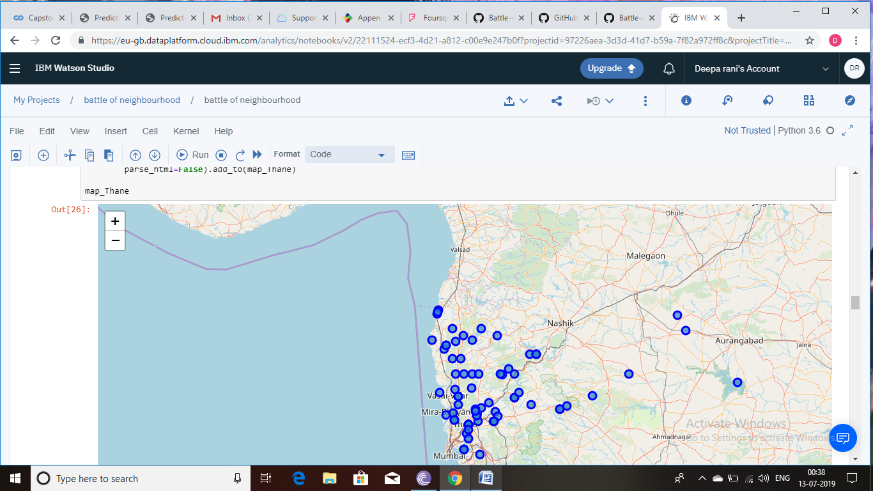

Slide 7
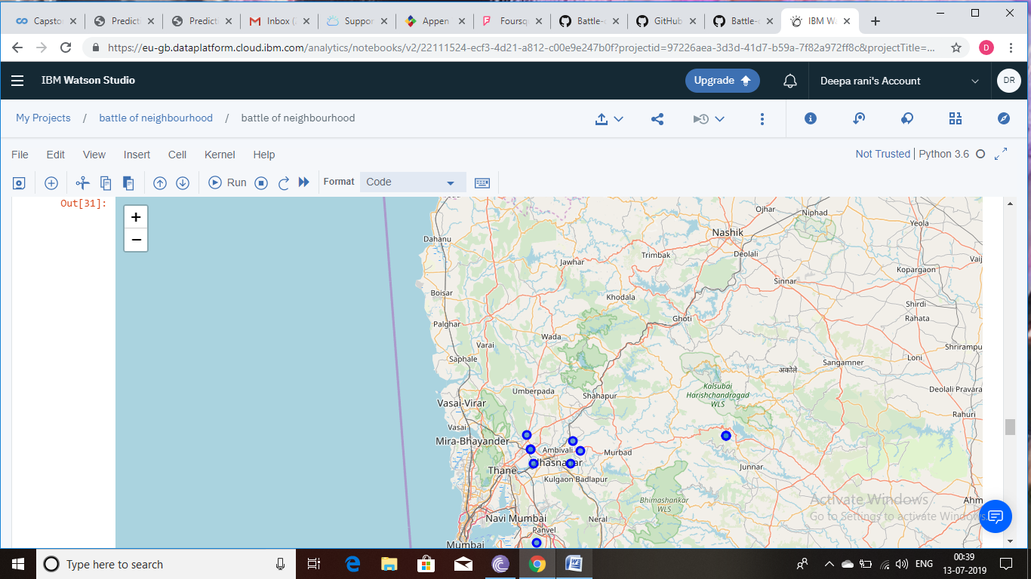
Result
By analyzing the map i extracted that kalyan area of thane has most numbers of spots.

Slide 8
Conclusion
● Built useful models to cluster similar places.
● Accuracy of the models has room for improvement.

